Slide 1
Luxurious Yet Lukewarm
Is Your Heart Lukewarm Towards God?
The Church of Laodicea (Rev. 3:14-22)
Dr Rick Griffith • Crossroads International Church Singapore • BibleStudyDownloads.org

Slide 2
The Lord's Prayer
Notes:
DON'T INTERRUPT ME LORD, I'M PRAYING (a 2-person skit reflecting on the Lord's Prayer by Clyde Lee Herring, adapted from Bread magazine, Nazarene Publishing House (http://www.murraymoerman.com/3downloads/don%27t_interrupt_me_lord_i%27m_praying.pdf)

Slide 3
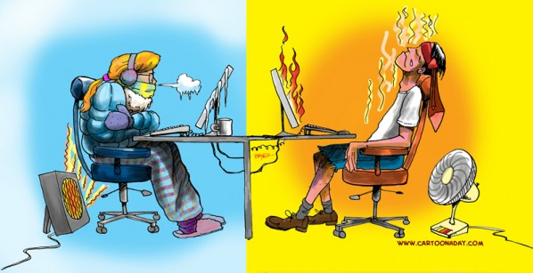
"We are either hot or cold with God."
The Extremes
Notes:
We’ve often been led to believe that “we are either hot or cold with God.”

Slide 4
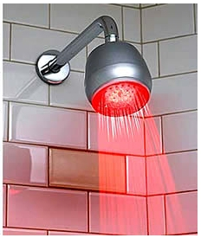
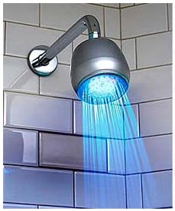
But are there only two options?
The Extremes
Notes:
Is that true? Are there only two options?

Slide 5
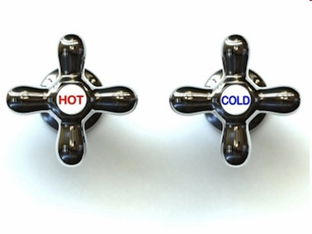
Luxurious Yet Lukewarm Laodicea
363
HOT
COLD
"I know all the things you do, that you are neither hot nor cold. I wish that you were one or the other!" (3:15 NLT)
Notes:
Today we’re going to unpack one of the amazing statements of Jesus, where he said, “I know all the things you do, that you are neither hot nor cold. I wish that you were one or the other!" (3:15 NLT).

Slide 6
Luxurious Yet Lukewarm Laodicea
363
HOT
COLD
"But… you are like lukewarm water, neither hot nor cold…" (3:16a NLT)

Slide 7
A Christian can be in the middle
The Spectrum
Notes:
If I understand this correctly, a Christian can be in the middle—neither hot nor cold but lukewarm.

Slide 8
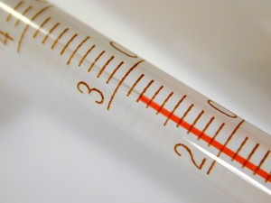
Are you lukewarm?
Notes:
Are you lukewarm towards Christ?
How would you know if you are lukewarm?
Well, please let the penetrating eye of Christ test your spiritual temperature.
You might not even care about this question—if so, you are clearly lukewarm at best—maybe even cold!

Slide 9
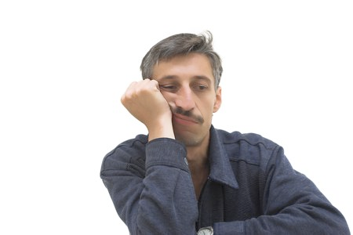
How can you cure spiritual apathy?
Notes:
But suppose you DO care if you might be apathetic. How, then, can you CURE spiritual apathy?

Slide 10
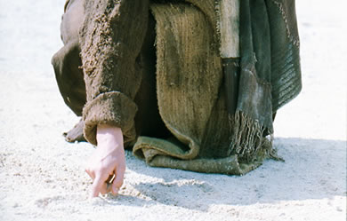
What does Jesus think of you?
Notes:
The most important thing about you is what Jesus thinks of you, so…

Slide 11
If Jesus wrote a letter to you, what would Jesus say?
L
Laodicea
Notes:
What if Jesus could just write you a letter to let you know if you are apathetic? What would Jesus say?
Well, he didn't write to you, but he did write to an apathetic church. Maybe we can learn something from reading someone else's mail!

Slide 12
Revelation
The Seven Churches of Revelation
The Writing Ministry of Jesus
This is the last of the seven letters of Revelation 2–3
Notes:
Jesus actually wrote seven letters to churches in Revelation 2-3. We will look at the last of these letters written to Laodicea.

Slide 13
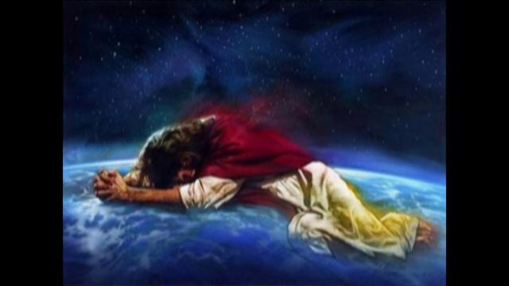
What was Laodicea like?

Slide 14
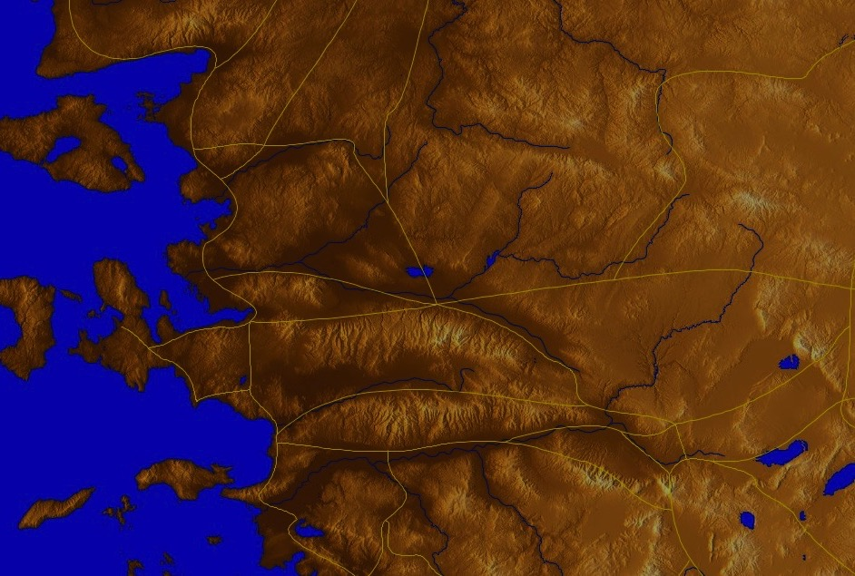
The 7 Churches (Rev. 2–3)
345
Adramyttium
Aezani
Pergamum
Thyatira
Cyme
Erythrae
Sardis
Smyrna
Eumenia
Philadelphia
Lebedus
Colophon
Ephesus
Nysa
Laodicea
Hierapolis
Trailes
Heraclea
Aphrodisias
Colossae
Alabanda
Patmos
Miletus
Notes:
It was the last of these letters linked by a trade route.

Slide 15
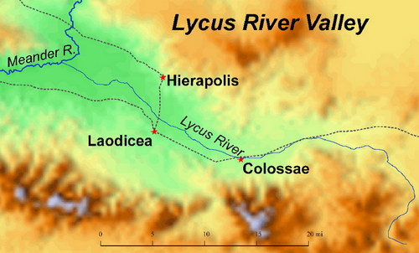
Lycus River Valley
Meander R.
Hierapolis
Lycus R.
Laodicea
Colossae
Laodicea's strategic location
Notes:
Laodicea lay on the major east-west trade route.

Slide 16
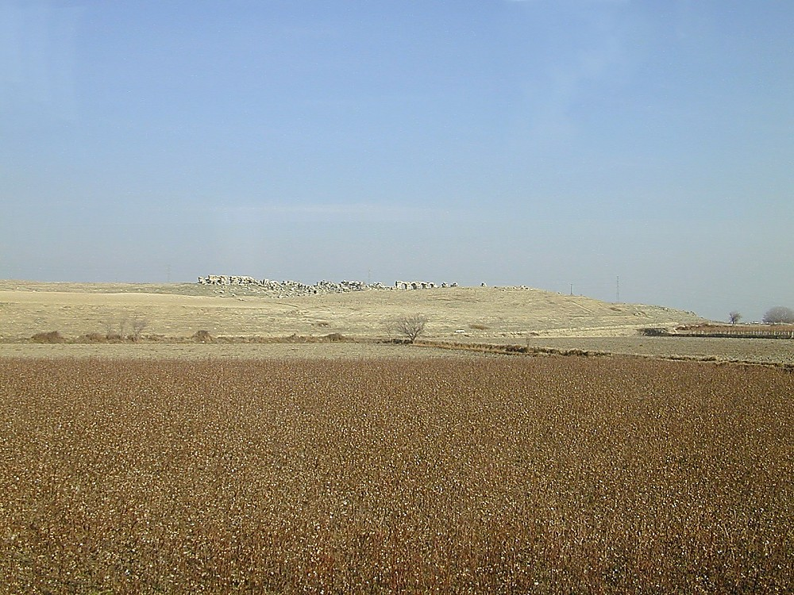
Laodicea tell from southwest
Laodicea tell from southwest
Notes:
Its significance lay in this strategic location.
_____________________
Historical Background
Antiochus the Great (261-246 B.C.), Seleucid king of Syria after the death of Alexander the Great, fortified Diospolis/Rhoas (in modern Turkey) between 261 and 253 B.C. This he made into a Seleucid outpost, naming it "Laodicea" after his wife, Laodice, whom he later divorced. Laodicea's formal name was "Laodicea on the Lycus" (Laodicea ad Lycum), or "Laodicea of Asia," to distinguish it from six other Seleucid cities with the same name.
Situated on a plateau of the Lycus River Valley at the junction of the north-south road from Pergamum to the Mediterranean and east-west road from Ephesus to the interior of an Asia Minor, Laodicea was an important commercial city. Ephesus lay about one hundred miles to its west and Philadelphia about forty miles to its northwest. Laodicea was one of a triad in this valley: six miles to the north was Hierapolis, noted for its wool industry, and eleven miles to the east was Colossae.
In 133 B.C. the city came under the Pax Romana and greatly prospered. First century B.C. Roman statesman and philosopher Cicero, proconsul of Cilicia, lived in Laodicea in 50 B.C. and cashed his letters of credit here, for it was a strategic banking center and prosperous city. Even the Talmud spoke scornfully of the life of ease and laxity lived by the Laodicean Jews.
In 26 A.D. Laodicea was among several cities in Asia competing for the honor of erecting a temple to emperor Tiberias, but it lost out to Smyrna. Only later, during the reigns of Commodus and Carcalla (180-217 A.D.), was it granted the coveted title of "Temple-Warden."
In the 4th century A.D., Laodicea, called at the time the "Metropolis of Asia," was the capital of West Phrygia. Its prosperity continued into the 5th century, when an earthquake devastated it (494 A.D.). As nearby Denizli grew, many natives there immigrated into Laodicea and under Turkish rule named it "Ladik," but they could not revive its former greatness. Laodicea was finally abandoned in the 13th century A.D.
(Todd Bolen, "Laodicea," in The Pictorial Library of Bible Lands, slide 2)

Slide 17
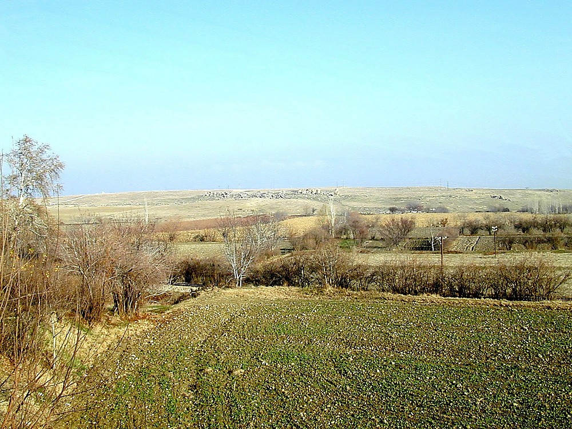
Laodicea tell from south
7500 Jewish men alone!
Laodicea tell from south
Notes:
The city had a large Jewish population of 7,500 Jewish men alone! The first Christians there were likely Jews.
________
Jewish Influence and the Church
Laodicea's original settlers were mostly from Syria, but Antiochus also settled a significant number of Jewish families here and in nearby Hierapolis and Colossae. At its height the city had about 7500 Jewish men alone, calculated by a shipment of temple tax seized by governor Flaccus on his way to Jerusalem. This large Jewish population of Laodicea probably formed the nucleus of the early Christian community.
(Todd Bolen, "Laodicea," in The Pictorial Library of Bible Lands, slide 3)

Slide 18
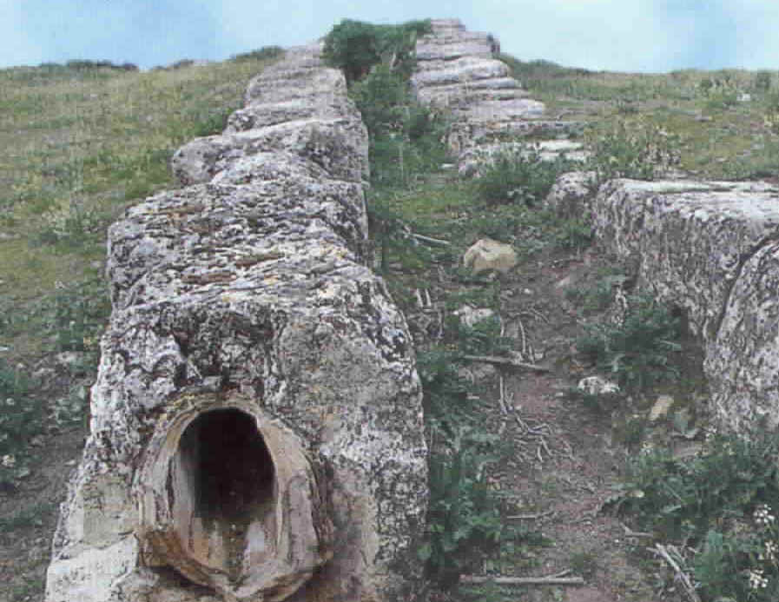
Hot and Cold Channels
Notes:
It had an elaborate pipe system to bring hot and cold water to the city.

Slide 19
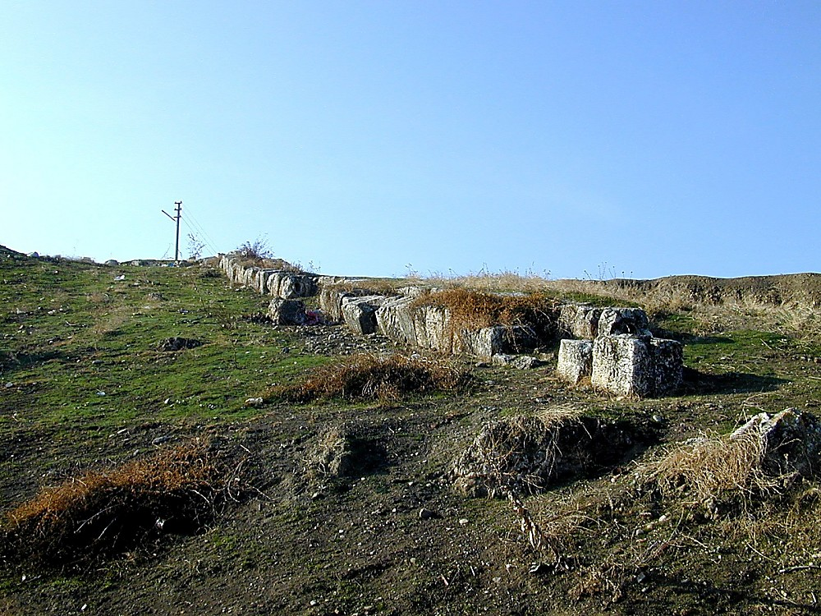
Laodicea aqueduct south of tell
Laodicea aqueduct south of tell
Notes:
Remnants of this marvel of engineering remain today in the aqueduect remnants.
(Todd Bolen, "Laodicea," in The Pictorial Library of Bible Lands, slide 8)

Slide 20
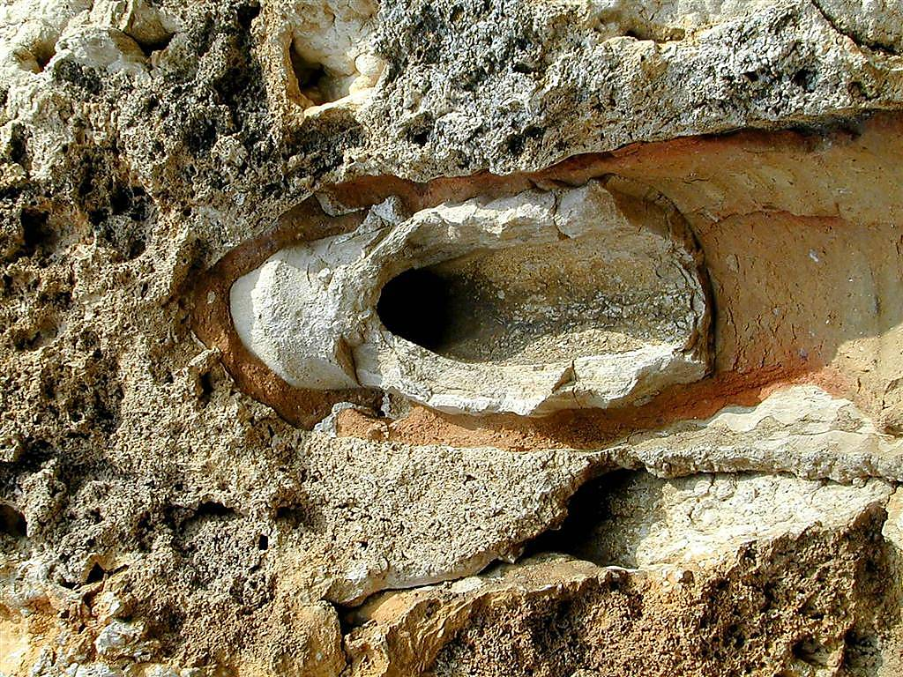
Laodicea pipe with calcium
Laodicea pipe with calcium
Notes:
Laodicea did not have its own water supply, but instead imported it via an aqueduct, which has calcium deposits that caused vomiting.
____________
Interpreting "Hot" and "Cold": One View (cont.)
Laodicea was located six miles from Hierapolis (Pamukkale today) which has hot springs which are valuable for medicinal purposes (in ancient times and today). Laodicea is located not far away from Colossae (supported by the sharing of the letter to the Colossians; Col 4:13, 16), which is home to springs that form a cold, pure source of water. Laodicea did not have its own water supply, but instead imported it from a town to the south of the city by means of an aqueduct. This water supply was not only warm but emetic (caused vomiting). The vomiting was/is not necessarily caused by the temperature of the water, but by its quality. The latter is attested by the heavy deposits visible on the aqueduct pipes. Ancient and modern sources speak of the poor quality of the water. The point seems to be that Jesus is unhappy with the deeds of the Laodiceans and he uses a metaphor to make his point clear: their deeds were not satisfying to Jesus; if they had been hot like Hierapolis, they would have served an important purpose. If they had been cold like Colossae, they also would have had a value. But their deeds were like the untasty water that flowed into their city.
(Todd Bolen, "Laodicea," in The Pictorial Library of Bible Lands, slide 10)

Slide 21
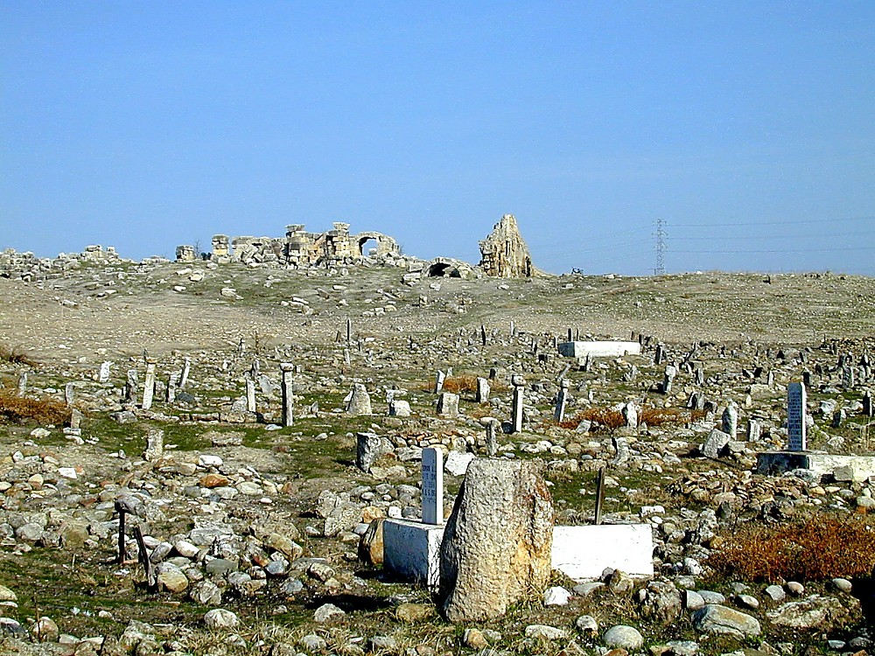
Laodicea graveyard with bathhouse remains
Marble everywhere (wealthy!)
Two theatres, a stadium, etc.
Graveyard with bathhouse on hill
Notes:
Excavations in the 1960s revealed a large city with marble everywhere, two theatres, a stadium and a huge bathhouse.
___________
Excavations
A Canadian team led by Jean des Gagniers in 1961-1963 carried out a small-scale excavation of Laodicea, focusing on the nymphaeum (dated to the early third century A.D.). Very little archaeological work has actually been done at Laodicea, and most of the remains lie in ruins. Nonetheless, it is a large, impressive tell, marble remains everywhere showing wealth of the city. Some archaeological points of interest in the ruins today include inscriptions, two theatres, a stadium, a gate, and a large visible building thought to be a bathhouse.
(Todd Bolen, "Laodicea," in The Pictorial Library of Bible Lands, slide 6)

Slide 22
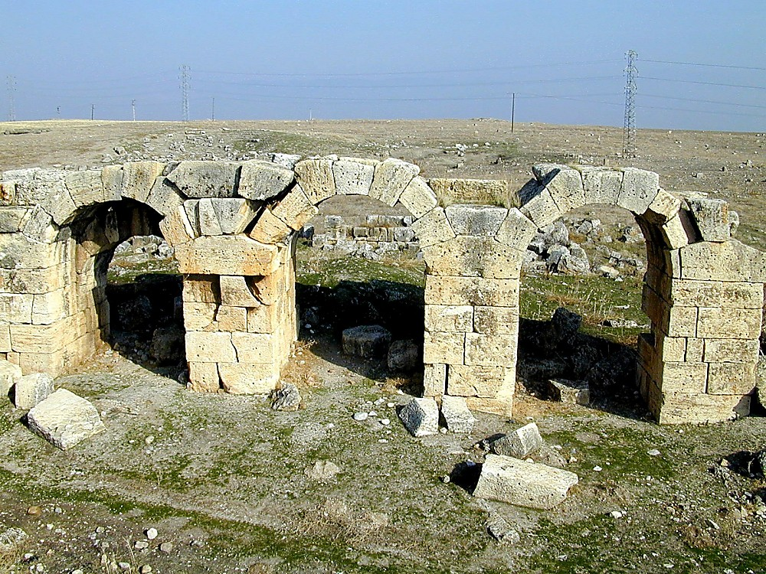
Laodicea bathhouse arches
Laodicea bathhouse arches
Notes:
Some of the bathhouse arches still stand.
_________
(Todd Bolen, "Laodicea," in The Pictorial Library of Bible Lands, slide 14)

Slide 23
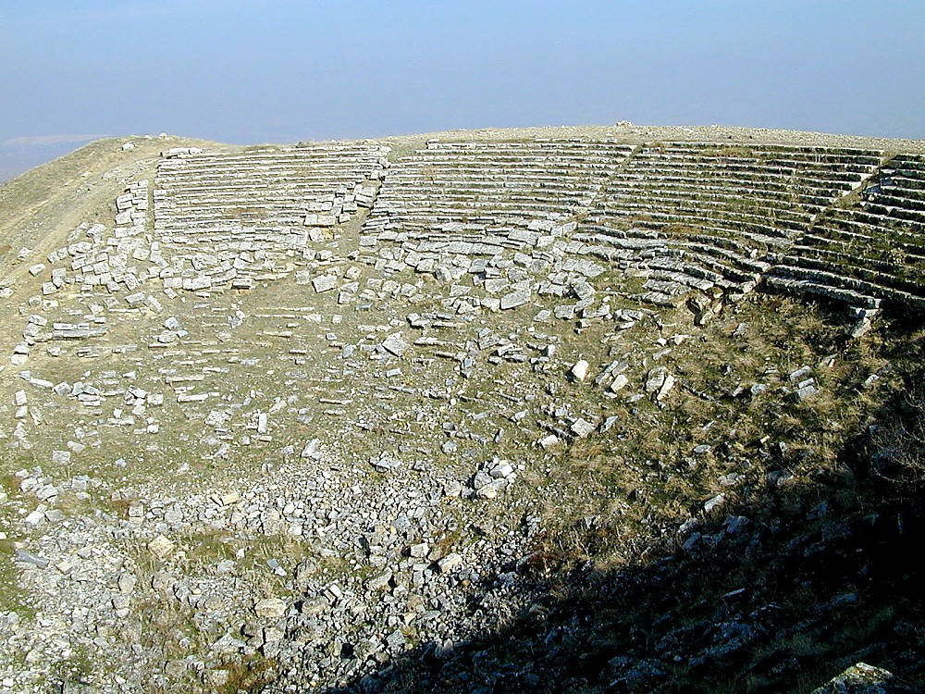
Laodicea Greek theater
Laodicea Roman theater
Notes:
…as does the Roman theater…
__________
(Todd Bolen, "Laodicea," in The Pictorial Library of Bible Lands, slide 28)

Slide 24
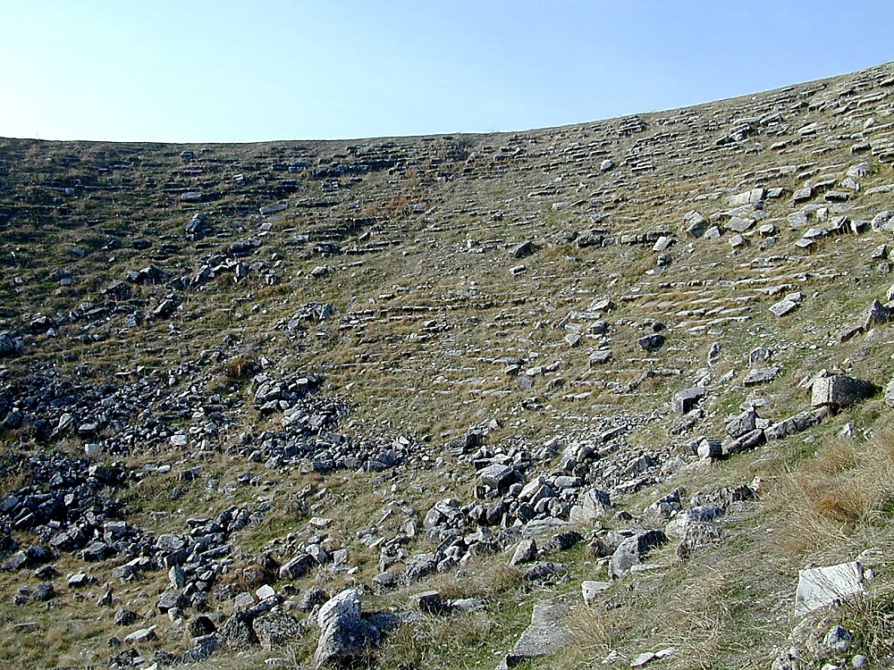
Laodicea Greek theater
Laodicea Greek theater
Notes:
…and the Greek theatre. Typical of wealthy people is plenty of time and money to go to the theater!
____________
(Todd Bolen, "Laodicea," in The Pictorial Library of Bible Lands, slide 29)

Slide 25
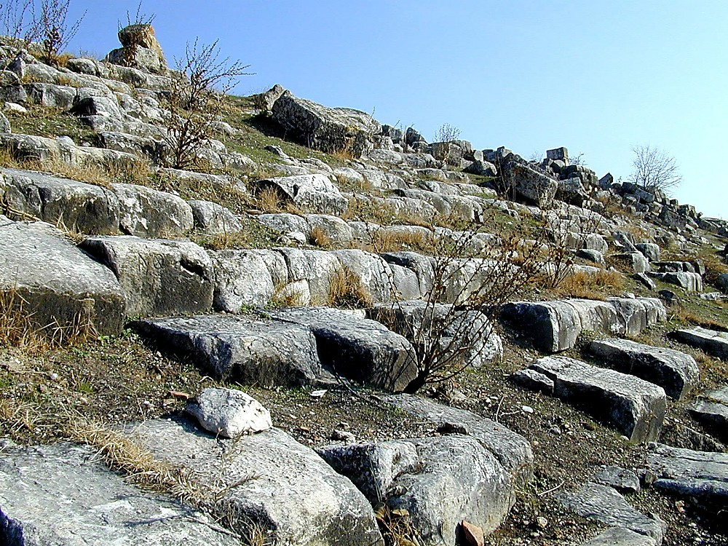
Laodicea stadium seating northern side
Laodicea stadium seating
Notes:
So the people would sit in on these exquisite seats, now in ruins.
_______________
(Todd Bolen, "Laodicea," in The Pictorial Library of Bible Lands, slide 20)

Slide 26
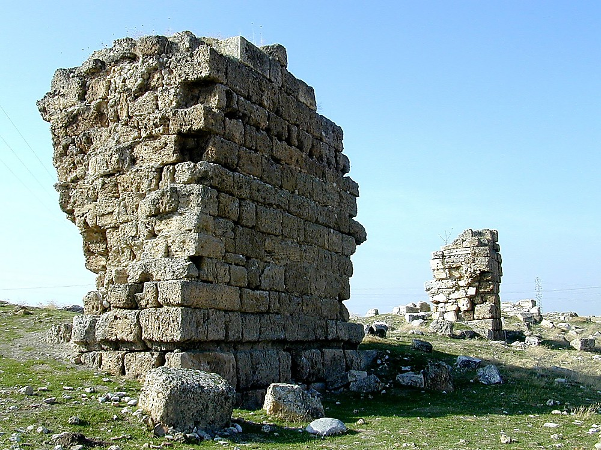
Laodicea walls still standing
Laodicea walls still standing
Notes:
…and they found protection from strong city walls, some which still stand tall.
______________
(Todd Bolen, "Laodicea," in The Pictorial Library of Bible Lands, slide 31)

Slide 27
Be Hot!
Three "Rs" to cure apathy…
Rev. 3:14-22
Notes:
In this letter to these wealthy and compromised Christians we will see “three Rs” to cure apathy. I encourage you to fill in these three words that begin with "R" as we go along. Here is the first…

Slide 28
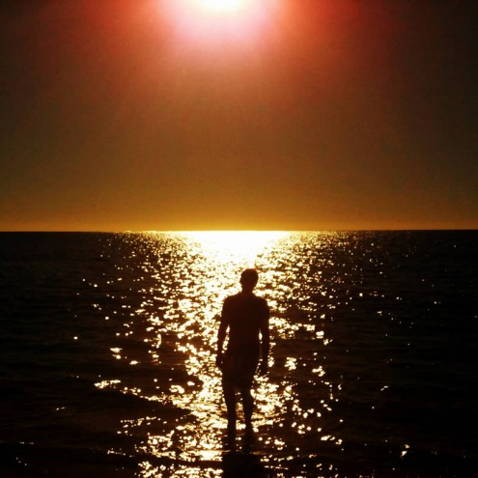
I. Recognize Christ's authority
The first way to cure spiritual apathy is to…
Rev. 3:14
Notes:
Humbly realize the exalted state of the One we’re apathetic about!
Read 3:14

Slide 29
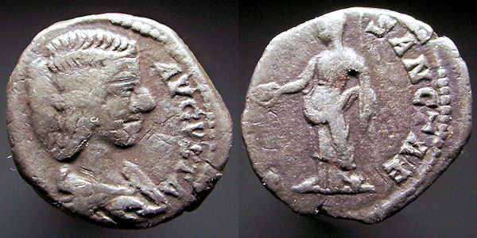
Luxurious Laodicea
363
Rebuilt own city after AD 17 earthquake
Notes:
Laodicea was luxurious and proud (3:14a).
They were proud of their money—their banking industry was world-renown.
____________________
"The city was very rich. They had also experienced damage from the AD 17 earthquake that decimated Philadelphia. But unlike Philadelphia, Laodicea was well capable of funding the city's rebuild on its own. In fact, the city also supplied funds to help rebuild several smaller cities in the area." http://www.truthwhys.com/news/revelation-part-15-chapter-3-sardis-philadelphia-and-laodicea/
Coin of Julia Domna, AD 197, mother of Caracalla, AR (Silver) Denarius, 3.12 gm, minted in Laodicea, SearM-6614 obv.: "[IVLIA] AVGVSTA" Bare-headed and draped bust right rev.: "VESTAE SANCTAE" Vesta standing left,
http://ettuantiquities.com/roman_coins_page_21.htm holding patera and scepter.

Slide 30
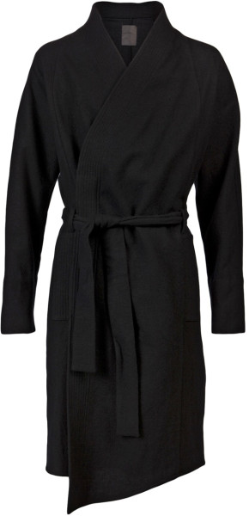
Laodicea Garment Industry
363
Notes:
They were proud of their clothes—their black wool allowed them all to dress in black.
_______________
The church is "naked," a local allusion which relates to the major industry of the entire region: the manufacture and preparation of textiles. Laodicea's glossy, black wool earned her a grand reputation, and her citizens wore black garments with pride, contrasting John's advice to the Christians of the city to buy "white raiment, that thou mayest be clothed."
(Todd Bolen, "Laodicea," in The Pictorial Library of Bible Lands, slide 7)

Slide 31
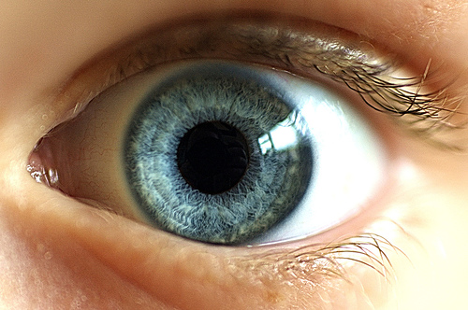
Laodicea Medical School
363
Exported an eye salve throughout the Roman Empire
Notes:
They were proud of their optical school—they sent an eye ointment throughout the Roman Empire.

Slide 32
Ruler: Jesus is the sovereign, faithful Creator (3:14b)
363
Pergamum
Thyatira
Christ: The Amen, the faithful and true Witness, the Ruler of God's creation
Smyrna
Sardis
Ephesus
Philadelphia
Laodicea
Notes:
__________
http://www.truthwhys.com/news/revelation-part-15-chapter-3-sardis-philadelphia-and-laodicea/ has many good historical notes

Slide 33
Jesus is the "So Be It" (cf. 1:6)!
"The Amen"
Notes:
What does it mean that Jesus is the “Amen” (3:14b)?
“Amen” means “so be it,” so Christ is the sovereign ruler who declares what will be.
When we say “Amen,” we don’t proclaim anything into reality. Instead, we acknowledge Christ’s authority. We say Amen but he is the Amen!

Slide 34
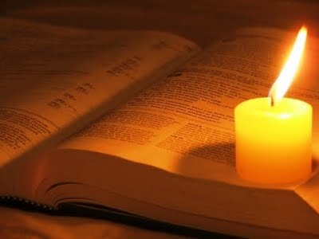
"the faithful and true witness"
Jesus reveals the End (cf. 1:5)
Notes:
What does it mean that Jesus is the “faithful and true witness” (3:14c)?
The phrase in 1:5 means Jesus is the faithful source of the book of Revelation.
So he is a true witness of the evidence about to be shown about Laodicea.

Slide 35
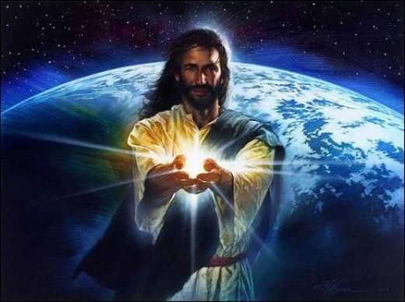
"Ruler (Beginning, Head, First) of all creation" (cf. 21:6)
Notes:
What does it mean that Jesus is the “beginning of God’s [new NLT] creation” (3:14c)? Does this mean Jesus is created?
We like to lower Christ to make ourselves look better. Nearby Colossae followed the error that Jesus was less than God some 35 years earlier. But a “created Jesus” would contradict the other descriptions of Christ as eternal in 1:18 and 2:8.
The better sense is that Jesus is the Creator himself. He is the authority to whom we will give an account of our lives!

Slide 36
I. Recognize Christ's authority
The first way to cure spiritual apathy is to…
Rev. 3:14
Notes:
Humbly realize the exalted state of the One we’re apathetic about!
So the first way to cure spiritual apathy is to see our true relationship with Christ—he is God and we are not. The second way to cure spiritual apathy is to…

Slide 37
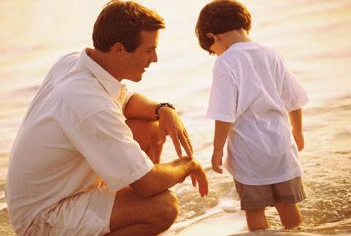
II. Respond to Christ’s rebuke
The second way to cure spiritual apathy is to…
Rev. 3:15-16
Notes:
Jesus lovingly corrects us in our lukewarm state.

Slide 38
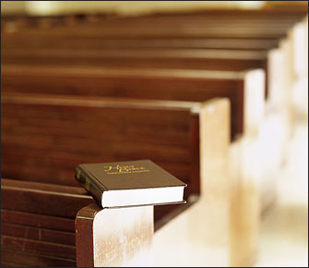
Reality: We can be active but compromised (3:15-16a).

Slide 39
Laodicea (Rev. 3:14-22)
363
Pergamum
Thyatira
Rebuke
Lukewarm, neither cold nor hot.
Christ: The Amen, the faithful and true Witness, the Ruler of God's creation
Commendation:
None!
Smyrna
Sardis
Ephesus
Philadelphia
Laodicea
Notes:
This is the rebuke by Christ: lukewarm, not cold or hot.
________________
http://www.truthwhys.com/news/revelation-part-15-chapter-3-sardis-philadelphia-and-laodicea/ has many good historical notes

Slide 40
Luxurious Yet Lukewarm Laodicea
363
HOT
COLD
"I know all the things you do, that you are neither hot nor cold. I wish that you were one or the other!" (3:15 NLT)
Notes:
“I know all the things that you do…” [read 3:15]

Slide 41
Luxurious Yet Lukewarm Laodicea
363
HOT
COLD
"But… you are like lukewarm water, neither hot nor cold…" (3:16a NLT)

Slide 42
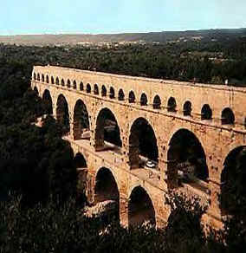
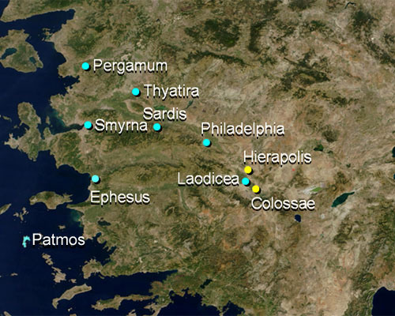
Laodicea Aqueduct
363
Notes:
The city had poor water resources so it had its water channeled from nearby cities. With their vast wealth, the people of Laodicea built an elaborate aqueduct system. Hardly anything remains of the aqueduct. This picture at the upper right are from another city.

Slide 43
Lycus River Valley
Meander R.
Hierapolis
Hot springs
Lycus R.
Laodicea
Lukewarm
Colossae
H
C
L
Cold springs
Laodicea had money but no water
Notes:
Hot water was piped from the nearby Hierapolis hot springs to the north. Cold water came via aqueduct from Colossae’s cold, refreshing springs to the east. However, to their horror, after the entire project was finished, they discovered that by the time the water reached Laodicea, it was lukewarm!
H + C = L or Hierapolis + Colossae = Laodicea or Hot + Cold = Lukewarm
It also had a high calcium content so that it made people vomit it out!
Both lines use thick terracotta pipes with a double siphon system. It has a modern water system now, but the remains of calcium carbonite remain on the ancient pipes. It ended with central and southern distribution centers. Colossae lay only 2.5 miles to the east.

Slide 44
Most prefer one or the other
Hot & Cold Drinks
Notes:
Most people preferred drinks either hot or cold back then—and today too.

Slide 45
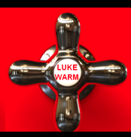
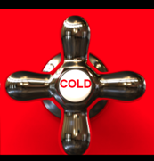
On fire for Christ!
Spiritual Fervor
HOT
LUKE WARM
COLD
Pretender
Reject Christ
Notes:
What does hot, cold and lukewarm mean (3:15-16a)? I think this refers to spiritual fervor:
• “Hot” means we have a fire for Christ—an excitement about him. • His command, of course, is for us to have a spiritual “fire” for him.
• “Cold” indicates spiritual opposition • where we reject Christ.
• “Lukewarm” Christians compromise • and only pretend to be walking with Christ.

Slide 46
On fire for Christ!
"I wish that you were cold or hot" (3:15b). Really? Why?
HOT
LUKE WARM
COLD
Pretender
Reject Christ
Notes:
Why would Christ actually prefer for people to be either hot or cold (3:15b)?
Jesus prefers for us to honest with him since he knows our true spiritual condition anyway.

Slide 47
"Cold"
Rejecting Christ
Notes:
It’s better to admit that we are “cold”—to say that we are rejecting him…

Slide 48
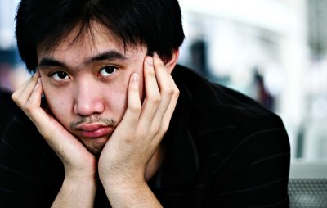
"Lukewarm"
Apathetic
Notes:
…than it is to pretend that we are not. Lukewarm means apathetic.

Slide 49
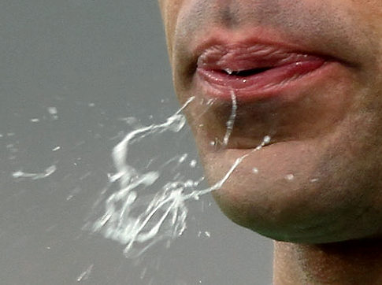
Result: Christ stops compromise (3:16b).
"I will spit you out of my mouth"
Notes:
Laodicea’s lukewarm water and calcium made a visitor want to vomit!

Slide 50
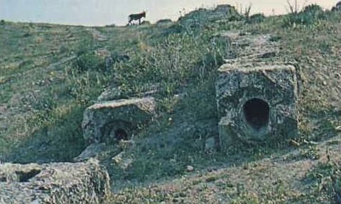
Laodicea Water Supply
363
Laodicea's water channelled through this dual pipeline but it carried thick calcium impurities. Combined with its lukewarm temperature, it would make a visitor vomit.

Slide 51
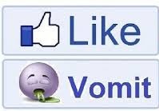
What does it mean for Jesus to vomit out the lukewarm?
Lose their salvation?
Lose their privileges by being disciplined!
Notes:
• Those who are spiritually complacent will not lose their salvation, for many other texts show us that those who genuinely know Christ have eternal life.
• It seems better to see this as Christ taking away their privileges in discipline.

Slide 52
The Chiasm (Rev. 2–3)
366
Ephesus
Existence Threatened
Smyrna
Faithful in Persecution
Pergamum
Mixed Bag
Thyatira
Sardis
Philadelphia
Laodicea
Notes:
This is exactly what happened. The existence of the church's witness was threatened as was Ephesus. This was no empty warning.

Slide 53
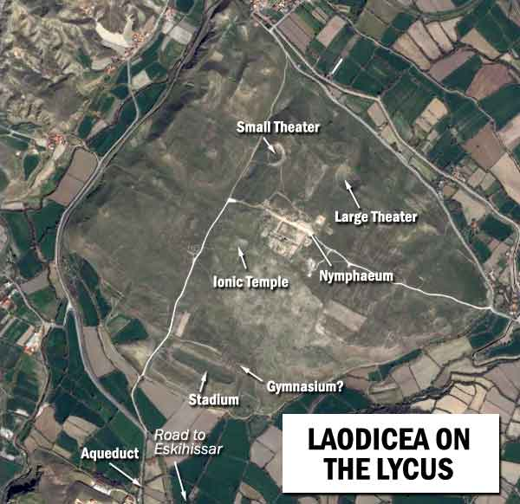
Laodicea Today
363
"I will spit you out of my mouth" (3:16)
LAODICEA ON THE LYCUS
Notes:
Laodicea’s lukewarm spiritual attitude eventually led to the destruction of the city. Since the 13th century AD it has been in ruins.

Slide 54
Singapore "Super Trees"
Notes:
The amazing Singapore “super trees” that catch water…

Slide 55
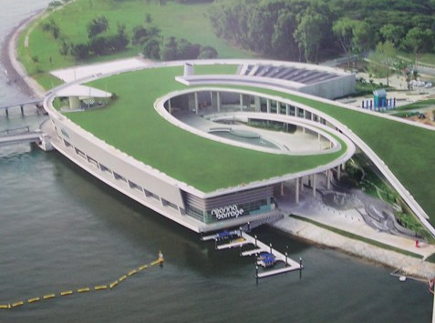
Marina Barrage Desalination Plant
Notes:
…and the state-of-the-art desalination plant…

Slide 56
Eventually…
Notes:
…will someday also be ruins.

Slide 57
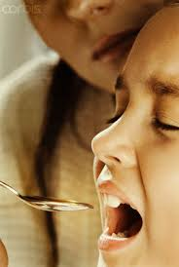
Jesus: "No, you make me sick!"
363
The Lukewarm: "Jesus, you make me sick!"
Notes:
Lukewarm Christians sometimes think that Jesus’ demands on their life make them sick.
• But do you make Jesus sick? Does Jesus say about you, "No, you make ME sick!"? Is he sick of your apathy, your compromise, your unwillingness to take a stand on anything for him?

Slide 58
I. Recognize Christ's authority
The first way to cure spiritual apathy is to…
Rev. 3:14
Notes:
Humbly realize the exalted state of the One we’re apathetic about!

Slide 59
II. Respond to Christ’s rebuke
The second way to cure spiritual apathy is to…
Rev. 3:15-16
Notes:
Jesus lovingly corrects us in our lukewarm state—so accept this gentle advice.

Slide 60
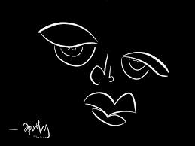
III. Receive Christ's riches and rule
The third way to cure spiritual apathy is to…
Rev. 3:17-22
Notes:
Christ’s solution to compromise is that we accept his generous offer instead of trusting ourselves!

Slide 61
Realize your sad state of spiritual self-sufficiency (3:17)
363
Pergamum
Thyatira
Rebuke:
Lukewarm, neither cold nor hot.
Wretched, pitiful, poor, blind, and naked
Christ: The Amen, the faithful and true Witness, the Ruler of God's creation
Commendation:
None!
Smyrna
Sardis
Ephesus
Philadelphia
Laodicea
Notes:
Read 3:17.
____________
http://www.truthwhys.com/news/revelation-part-15-chapter-3-sardis-philadelphia-and-laodicea/ has many good historical notes

Slide 62
Repent by trusting in Christ’s riches (3:18-19).
363
Pergamum
Thyatira
Exhortation
Buy from Christ refined gold, white clothes, and eye salve.
Be earnest and repent.
Rebuke
Lukewarm, neither cold nor hot.
Wretched, pitiful, poor, blind, and naked
Christ: The Amen, the faithful and true Witness, the Ruler of God's creation
Commendation:
None!
Smyrna
Sardis
Ephesus
Philadelphia
Laodicea
Notes:
Read 3:18-19.
____________
http://www.truthwhys.com/news/revelation-part-15-chapter-3-sardis-philadelphia-and-laodicea/ has many good historical notes

Slide 63
Luxurious Laodicea
363
Rebuilt own city after AD 17 earthquake
Notes:
"The city was very rich. They had also experienced damage from the AD 17 earthquake that decimated Philadelphia. But unlike Philadelphia, Laodicea was well capable of funding the city's rebuild on its own. In fact, the city also supplied funds to help rebuild several smaller cities in the area." http://www.truthwhys.com/news/revelation-part-15-chapter-3-sardis-philadelphia-and-laodicea/
Coin of Julia Domna, AD 197, mother of Caracalla, AR (Silver) Denarius, 3.12 gm, minted in Laodicea, SearM-6614 obv.: "[IVLIA] AVGVSTA" Bare-headed and draped bust right rev.: "VESTAE SANCTAE" Vesta standing left,
http://ettuantiquities.com/roman_coins_page_21.htm holding patera and scepter.

Slide 64
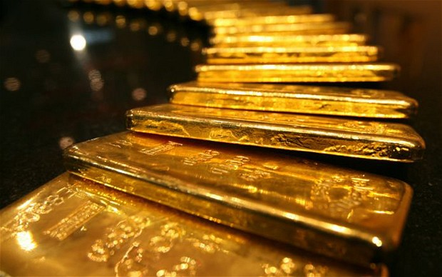
Luxurious Laodicea
363
Rebuilt own city after AD 17 earthquake
"So I advise you to buy gold from me—gold that has been purified by fire. Then you will be rich" (3:18a NLT)
Notes:
Our world-renown banks do not have true “gold” that will last for eternity!

Slide 65
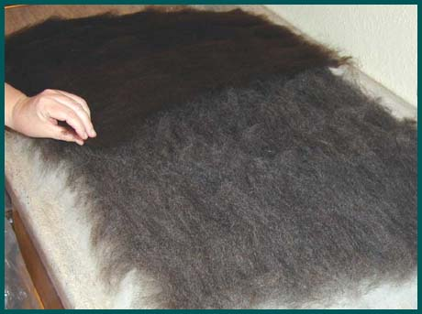
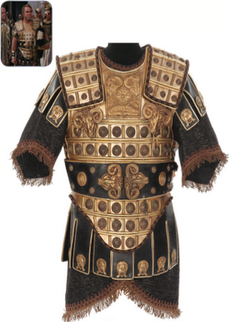
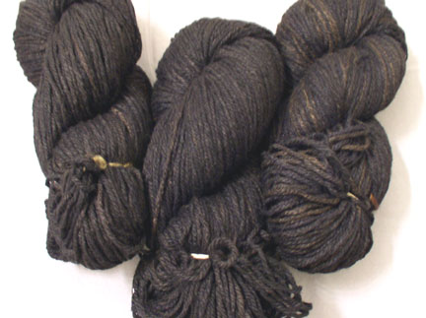
Laodicea Garment Industry
363
Produced a unique black wool
Notes:
Laodicea was world renown for its black wool that made garments such as the uniform for the Egyptian General Achillas, head of Pharaoh Ptolemy XIII's army.
_________
EGYPTIAN GENERAL JOHN DOUCETTE "ACHILLAS" COSTUME FROM CLEOPATRA. (TCF,1963) Designed by Vittorio Nino Novorese for John Doucette, who portrays Egyptian General Achillas, head of Pharaoh Ptolemy XIII's army in Cleopatra. Worn during Caesar's royal visit to Egypt to order the end of discord between Ptolemy and his sister Cleopatra. Constructed authentically by "Casa D'Arte Firenze" of heavy leather with numerous pressed, cast, and stamped metallic ornaments and medallions. Label inside is inscribed for re-purposing of "Ammiraglio Egiziano" as is the black and gold thread under-tunic which is from the same re- purposed screen-use. Excellent condition overall, with only a few of the smallest ornaments missing. $1,500 – $2,000 at http://beingcleopatra.blogspot.com/2011/12/cleopatra-up-for-auction.html

Slide 66
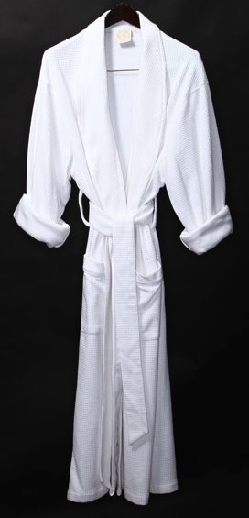
Laodicea Garment Industry
363
"Also buy white garments from me so you will not be shamed by your nakedness" (3:18b NLT)
Notes:
But Jesus said that the church is "naked," a local allusion which relates to the major industry of the entire region: the manufacture and preparation of textiles. Laodicea's glossy, black wool earned her a grand reputation, and her citizens wore black garments with pride, contrasting John's advice to the Christians of the city to buy "white raiment, that thou mayest be clothed."
(Todd Bolen, "Laodicea," in The Pictorial Library of Bible Lands, slide 7)

Slide 67
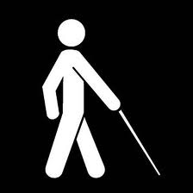
Medical School at the Temple of Asclepius
Exported an eye salve throughout the Roman Empire
"You are blind…" (3:17)

Slide 68
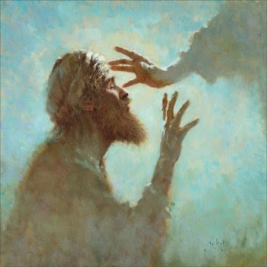
Laodicea Medical School
364
Exported an eye salve throughout the Roman Empire
"Buy… ointment for your eyes so you will be able to see" (3:18c NLT)
Notes:
Our thinking we can see is nothing like the eye ointment Christ gives for spiritual sight!

Slide 69
Luxurious Laodicea
363
The assessment by Jesus:

Slide 70
Laodicea (Rev. 3:14-22)
363
Warning
None!
But there is an invitation!
Pergamum
Thyatira
Exhortation
Buy from Christ refined gold, white clothes, and eye salve.
Be earnest and repent.
Rebuke
Lukewarm, neither cold nor hot.
Wretched, pitiful, poor, blind, and naked
Christ: The Amen, the faithful and true Witness, the Ruler of God's creation
Commendation:
None!
Smyrna
Sardis
Ephesus
Philadelphia
Laodicea
Notes:
Wiersbe notes, "There is no divine commendation given to this church. Of course, the Laodiceans were busy commending themselves! They thought they were glorifying God, when in reality they were disgracing His name just as though they had been walking around naked" (Wiersbe, 59).
There is nothing mentioned that they did good, but there is an invitation! Just like Jesus said to Philadelphia…
______
http://www.truthwhys.com/news/revelation-part-15-chapter-3-sardis-philadelphia-and-laodicea/ has many good historical notes

Slide 71
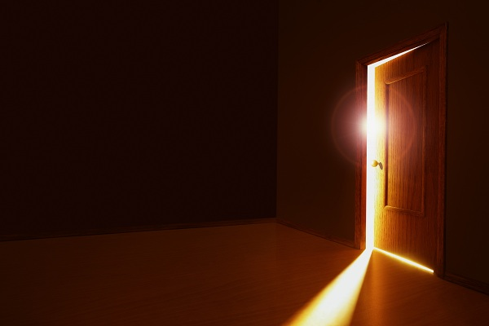
Jesus to Philadelphia
"…I have given you an open door that no one can shut…" (3:8)
Notes:
Christ gave Philadelphia an open door for ministry—and you know what? Christian testimony continues in Philadelphia even to today!

Slide 72
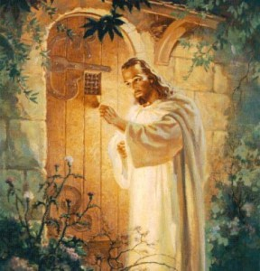
"Look! I stand at the door and knock. If you hear my voice and open the door, I will come in…" (3:20a NLT)
Receive Christ into your life
Notes:
Like the painting, no handle is on the outside. Jesus is a gentleman who will not knock the door down to force his way into your life. You must open the door from the inside.

Slide 73
"Look! I stand at the door and knock. If anyone hears…" (3:20a NLT)
Is the invitation to a believer or non-believer?
Notes:
This was an appeal to Christians rather than to non-Christians, but does it really matter? Neither the believer nor the unbeliever were experiencing genuine fellowship with Christ! He says, "…if anyone hears my voice…"
The letter is written to believers who were living like unbelievers.

Slide 74
"…and we will share a meal together as friends" (3:20b NLT)
Receive Christ into your life
Notes:
The word' for "dine" here refers to the main meal of the day—the evening dinner. "This mealtime was set aside for relaxation, enjoyment, and fellowship" (Swindoll, Letters to Churches…Then and Now, 53).
Isn't it true today too? Your most personal place is your home. Invite him in!

Slide 75
Rule with Christ just as he rules with the Father (3:21-22).
365
Notes:
Read 3:21-22.
Here is the amazing promise from Jesus!

Slide 76
Laodicea (Rev. 3:14-22)
363
Promise
Overcomers will eat with Christ and rule with Christ
Warning
None!
Pergamum
Thyatira
Exhortation
Buy from Christ refined gold, white clothes, and eye salve.
Be earnest and repent.
Rebuke
Lukewarm, neither cold nor hot.
Wretched, pitiful, poor, blind, and naked
Christ: The Amen, the faithful and true Witness, the Ruler of God's creation
Commendation:
None!
Smyrna
Sardis
Ephesus
Philadelphia
Laodicea
Notes:
"Those who are victorious will sit with me on my throne, just as I was victorious and sat with my Father on his throne" (3:21 NLT).
____________
http://www.truthwhys.com/news/revelation-part-15-chapter-3-sardis-philadelphia-and-laodicea/ has many good historical notes

Slide 77
The Overcomers (Rev. 2–3)
365
Pergamum
Thyatira
"He who overcomes" (NAU) is used once for each of the 7 churches, plus 21:7 with a total of 8 times in Revelation
Smyrna
Sardis
Ephesus
Philadelphia
Laodicea

Slide 78
The Overcomers (Rev. 2–3)
365
Pergamum
Thyatira
To him who overcomes, I will grant to eat of the tree of life which is in the Paradise of God (2:7)
Smyrna
Sardis
Ephesus
Philadelphia
2:7
Laodicea

Slide 79
The Overcomers (Rev. 2–3)
365
Pergamum
Thyatira
He who overcomes will not be hurt by the second death (2:11)
Smyrna
Sardis
2:11
Ephesus
Philadelphia
2:7
Laodicea

Slide 80
The Overcomers (Rev. 2–3)
365
Pergamum
Thyatira
To him who overcomes, to him I will give some of the hidden manna, and I will give him a white stone, and a new name written on the stone which no one knows but he who receives it (2:17)
2:17
Smyrna
Sardis
2:11
Ephesus
Philadelphia
2:7
Laodicea

Slide 81
The Overcomers (Rev. 2–3)
365
Pergamum
Thyatira
2:17
2:26
He who overcomes, and he who keeps My deeds until the end, TO HIM I WILL GIVE AUTHORITY OVER THE NATIONS (2:26)
Smyrna
Sardis
2:11
Ephesus
Philadelphia
2:7
Laodicea

Slide 82
The Overcomers (Rev. 2–3)
365
Pergamum
Thyatira
2:17
2:26
He who overcomes will thus be clothed in white garments; and I will not erase his name from the book of life, and I will confess his name before My Father and before His angels (3:5)
Smyrna
Sardis
2:11
3:5
Ephesus
Philadelphia
2:7
Laodicea

Slide 83
The Overcomers (Rev. 2–3)
365
Pergamum
Thyatira
2:17
2:26
He who overcomes, I will make him a pillar in the temple of My God, and he will not go out from it anymore; and I will write on him the name of My God, and the name of the city of My God, the new Jerusalem, which comes down out of heaven from My God, and My new name (3:12)
Smyrna
Sardis
2:11
3:5
Ephesus
Philadelphia
2:7
3:12
Laodicea

Slide 84
The Overcomers (Rev. 2–3)
365
Pergamum
Thyatira
2:17
2:26
He who overcomes, I will grant to him to sit down with Me on My throne, as I also overcame and sat down with My Father on His throne (3:21)
Smyrna
Sardis
2:11
3:5
Ephesus
Philadelphia
2:7
3:21
3:12
Laodicea

Slide 85
The Overcomers (Rev. 2–3)
365
Pergamum
Thyatira
2:17
2:26
Smyrna
He who overcomes will inherit these things, and I will be his God and he will be My son (21:7)
Sardis
2:11
3:5
Ephesus
Philadelphia
2:7
3:21
3:12
Laodicea

Slide 86
How can you cure spiritual apathy?
Notes:
Once again, to the question where we started… what is the way to get out of our compromise with Jesus?

Slide 87
Replace self-reliance with Christ-reliance
Main Idea
Notes:
Stop trusting yourself. Start trusting Jesus.

Slide 88
Be Hot!
Three "Rs" to cure apathy…
Rev. 3:14-22

Slide 89
I. Recognize Christ's authority
The first way to cure spiritual apathy is to…
Rev. 3:14
Notes:
Humbly realize the exalted state of the One we’re apathetic about!

Slide 90
II. Respond to Christ’s rebuke
The second way to cure spiritual apathy is to…
Rev. 3:15-16
Notes:
Jesus lovingly corrects us in our lukewarm state—so accept this gentle advice.

Slide 91
III. Receive Christ's riches and rule
The third way to cure spiritual apathy is to…
Rev. 3:17-22
Notes:
Christ’s solution to compromise is that we accept his generous offer instead of trusting ourselves!

Slide 92
How are you like luxurious yet lukewarm Laodicea?
LUKEWARM… AND LOVING IT

Slide 93
What does lukewarm look like?
Loss of spiritual passion

Slide 94
What does lukewarm look like?
Not listening

Slide 95
Where are you on the continuum?
Don't be satisfied!
"To be satisfied with where you are spiritually is to commit spiritual suicide!"
—Lisa Haven
Notes:
"The problem wasn't that they needed their physical needs met. The problem was that they were utterly satisfied with where they stood with the Lord spiritually. They were living spiritually unhealthy lives and in my opinion committing spiritual suicide.
'To be satisfied with where you are spiritually is to commit spiritual suicide!'
If you are not moving towards God, then you are moving away from him. There is no in-between. Its either one or the other"
("The Church God Spit Out of His Mouth" by Lisa Haven in BIBLICAL ANSWERS, END TIMES http://vineoflife.wordpress.com/2013/04/08/the-church-god-spit-out-of-his-mouth/ accessed 18 Jan 2014)

Slide 96
The Call of Jesus to Radical Commitment (Matt. 10:32-39)
"Everyone who acknowledges me publicly here on earth, I will also acknowledge before my Father in heaven. ³³ But everyone who denies me here on earth, I will also deny before my Father in heaven."
³⁴ "Don't imagine that I came to bring peace to the earth! I came not to bring peace, but a sword."

Slide 97
The Call of Jesus to Radical Commitment (Matt. 10:32-39)
³⁵ "I have come to set a man against his father, a daughter against her mother,
and a daughter-in-law against her mother-in-law.
³⁶ Your enemies will be right in your own household!"

Slide 98
The Call of Jesus to Radical Commitment (Matt. 10:32-39)
³⁷ "If you love your father or mother more than you love me, you are not worthy of being mine; or if you love your son or daughter more than me, you are not worthy of being mine. ³⁸ If you refuse to take up your cross and follow me, you are not worthy of being mine. ³⁹ If you cling to your life, you will lose it; but if you give up your life for me, you will find it."

Slide 99
"Look! I stand at the door and knock. If you hear my voice and open the door, I will come in…" (3:20a NLT)
Receive Christ into your life

Slide 100
Will you answer Jesus?
Jesus
mobile
Decline
Accept
Will you answer?
Notes:
Jesus is calling. Will you answer?

Slide 101
"Anyone with ears to hear must listen to the Spirit and understand what he is saying to the churches" (3:22 NLT)
Notes:
To "hear" means to "listen." To really "listen" means to respond positively.

Slide 102
Black

Slide 103
Jesus Wins!
Series on Revelation

Slide 104
NT Preaching link at BibleStudyDownloads.org
Get this presentation and script for free!
Notes:
NT Preaching (np)

